Slide 1


Slide 2
Staged Delivery
Stage 0
Framework
Stage 1
Unit
Stage 2
Sensors
Power Source
DataHandler Subsystem

Slide 3
Staged Delivery
Stage 3
Storage Manager
DataHandler Subsystem
Stage 4
Calibration
Processing of Data
Algorithm
Storing Processed Data

Slide 4
Staged Delivery
Stage 5
Lights
DataHandler subsystem
Stage 6
Gui
Display Raw Data
Stage 7
Networking

Slide 5
Staged Delivery
Stage 8
GUI
Shows Raw Data
Shows Processed Data
Changes UIC
Calibrate option
Requests Stored Data
Stage 9
Gui Graph Data
GPS data
Gui GPS
Removable Storage

Slide 6
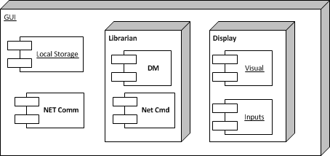
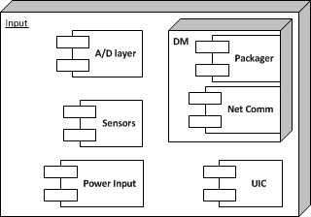
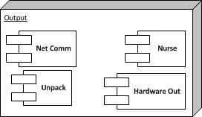
ADS Diagram

Slide 7
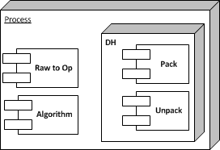
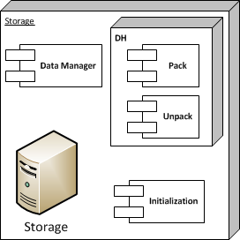
ADS Diagram

Slide 8
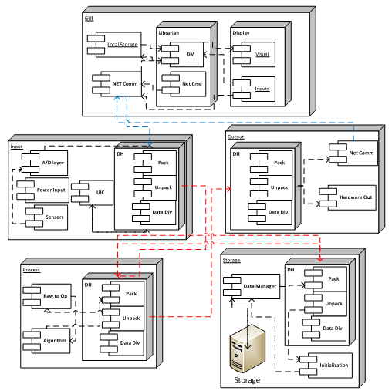
ADS Diagram

Slide 9
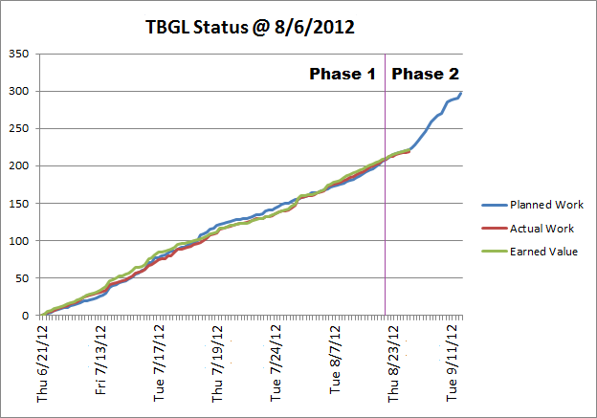
Work Progress

Slide 10
Work Outlook
ADS Document – Sept. 12
ADS Gate Review – Sept. 13
Team ITUS peer review – before Sept.14
Team Meetings
Meetings w/ Sponsor

